Slide 1
ICS 432 – 01 Distributed and Cloud Computing Fall 2021
Instructor: Thanaa Ghanem
thanaa.ghanem@metrostate.edu
Lectures 11
November 6, 2021

Slide 2
More Map-reduce Examples

Slide 3
Motivating Problems from MapReduce’s Paper
Computations are conceptually straightforward, however:
Input is large.
Computations must be distributed across hundreds or thousands of machines in order to finish in a reasonable amount of time.
Examples:
Count URL access frequency.
Reverse web-link log.
Build an inverted index (i.e., appendix)
Distributed sort for a large data set.

Slide 4
Example 1: Count of URL Access Frequency
Input: a list of URLs that are accessed in the past week (or month or year)
Problem: find the number of times each URL is accessed (frequency)
mapper: processes logs of web page requests and outputs <URL, 1>
reducer: adds together all values for the same URL and emits <URL, total count>

Slide 5
Example 2: Reverse web-link log
Input: a web log that shows for each web link, source, the other links that are referenced from source. For example, a line in the input file is as follows:
source_{i} target₁,target₂,target₃,target₄…....
Problem: show for each link, target, all sources that references the target. For example, a line in the output file is as follows:
target_{i} source₁,source₂,source₃…....
mapper:
Output <target_{i}, source_{j}> pairs for target_{i} value in the list of URLs attached to source_{j}
reducer:
Receives <target_{i}, list(source)> as input and passed them to the output as is.

Slide 6
Example 3: Inverted Index
Given word documents, an inverted index shows, for each word, the name of the documents that includes that word.
Similar to a book’s appendix.
mapper:
Parses each document and emits a sequence <word,document_id> pairs.
reducer:
Accepts all pairs for a given word, sorts the corresponding document ids and emits a <word,list_of_documnet_id)> pairs.
The set of all output pairs forms a simple inverted index.

Slide 7
Example 4: Distributed Sort
Given a list of records, produce a sorted list based on a certain attribute.
map:
Extracts the key from each record, and emits a <key, record> pair.
reduce:
Emits all pairs unchanged.
This mainly utilizes on the shuffle and sort steps in MapReduce framework.

Slide 8
Mapreduce Exercises
For each of the following exercises:
explain the map and reduce functions that can be used to produce the required output.
clarify the input and output keys and values for both the mapper and reducer.
Give example input and show the corresponding mapper and the reducer inputs/outputs.

Slide 9
Exercise 1
Input: a collections of text documents.
Required output: a list of words that appear at least 100 3 times in the documents.
Example input
Corresponding Output
Hello there how are you
Hello
I said Hello two times.
are you fine.
Where are you going.
Hello again.
Hello 4
you 3
are 3

Slide 10
Exercise 2
Input: text file containing flight data where each line in file has the following format:
flight_id, carrier_id, departure_city, destination_city, delay
Required output: find, for each city, the number of flights that either departed from or landed in the city.
Example input
Corresponding Output
1,AA,New York, Los Angeles, 10
2,DL,Los Angeles, New York10
3,SW,Minneapolis, Atlanta, 10
4,AA,Minneapolis, New York, 10
5,DL,New York, Atlanta, 10
6,AA,New York, Minneapolis, 10
Atlanta 2
New York 5
Minneapolis 3
Los Angeles 2

Slide 11
Exercise 3
Input: a set of text documents.
Required output: for each character of the alphabet, find the average length of all words that start with that character.
Example input
Corresponding Output
n 2.6 (3+3+2)/3
d 10.0
i 2.0
t 3.5 (3+4)/2
no now is definitely not the time

Slide 12
Exercise 4
Input: a set of text documents.
Required output: how many words are there of length 1, 2, 3 and so on
Example input
Corresponding Output
Hello there how are you doing today
3 3
5 4

Slide 13
Exercise 5
Input: data file that contains information about orders placed by customer. Each line in the file has the following format.
order_id, customer_id, product_id, cost
Required output:
Find how many orders are placed for each product.
For each customer, find the total cost of all orders placed by that customer.
Find the number of customers who spend in each range of spending: 0-99, 100-199, 200-299, 300-399, etc.

Slide 14
Exercise 5: part 1
Find how many orders are placed for each product.
Example input
Corresponding Output
1 c1 p1 10
2 c2 p3 90
3 c2 p4 80
4 c1 p1 40
5 c3 p2 50
6 c2 p4 60
7 c1 p1 70
8 c4 p1 70
p1 4
p2 1
p3 1
p4 2

Slide 15
Exercise 5: part 2
For each customer, find the total cost of all orders placed by that customer.
Example input
Corresponding Output
1 c1 p1 10
2 c2 p3 90
3 c2 p4 80
4 c1 p1 40
5 c3 p2 50
6 c2 p4 60
7 c1 p1 70
8 c4 p1 70
c1 120
c2 230
c3 50
c4 70

Slide 16
Exercise 5: part 3
The output of one mapreduce job can be used as input to another mapreduce job
Example input, output of part 2
Corresponding Output
c1 120
c2 230
c3 50
c4 70
0 2
1 1
2 1

Slide 17
Mappers and Reducers in Details

Slide 18
Key words
NameNode
DataNode
Resource Manager
NodeManager
Application Master
Job vs. Task vs. Task Attempt
HDFS Replication Factor (chosen based on cost of replication, probability of failues, and cost of data loss)
Pipeline of Write
Replica placement: Reliability vs. Bandwidth
Rack awareness
Heartbeats
Shuffle and Sort
Data Local Computing
Speculative Execution

Slide 19
Map-reduce can refer to
The programming model
The execution framework (aka runtime)
The specific implementation

Slide 20
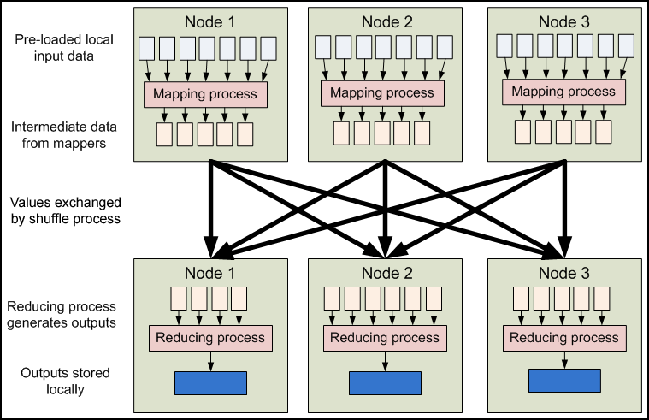
Overview of data flow in a mapreduce job

Slide 21
Overview of data flow in a mapreduce job
On each slave node in the cluster, local data is loaded into a mapping process as key-value pairs from HDFS
The mapper outputs zero or more key-value pairs according to the logic of map function.
These pairs are then sorted and shuffled based on the key.
The output of shuffle & sorts is then distributed to reducers.
The reducer output zero or more final key-value pairs for each input key.
The output of the reducer is written back to HDFS.

Slide 22
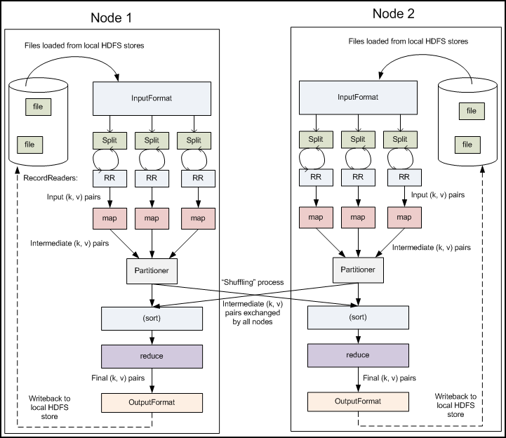
Details of data flow in a mapreduce job
Input → Split
Map
Shuffle & Sort
Reduce
Output

Slide 24
1.Input-> Split
Hadoop’s InputFormat class describes the input-specification for a MapReduce job.
InputFormat is responsible for:
Validating the input-specification of the job
Splitting up the input files(s) to input splits, each of which will be assigned to a Mapper
Good size for split size is as big as the block size
Provide the RecordReader, which actually reads the records from the input file and submits them (as key/value pairs) to the mapper

Slide 25
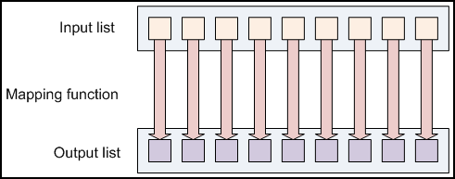
2. Map
Once the input data has been split into InputSplits and assigned to mappers, the RecordReader submits the input as key/value pairs to mappers
The mapper’s map() method performs the data analysis or other user-defined work and emits the resulting key/value pairs(s) to forward to the reducers.
Individual mappers cannot communicate with each other in any way and are not aware of one another, they are governed by the local NodeManager
The number of map tasks equal to the number of file blocks.
What is the number of reduce tasks?
Map tasks write its output to the local machine disk (not on HDFS)

Slide 26
3. Shuffle & Sort
When the mapping phase is completed, the emitted key/value pairs must be exchanged between machines to send all values with the same key to a single reducer.
This is the only required communication step between slave nodes in the cluster.
3.a. Shuffle:
The intermediary key space is partitioned by key subsets and assigned to individual reduce nodes
Each map task may emit (key,value) pairs to any partition, all values for the same key are always reduced together regardless of which mapper is its origin

Slide 27
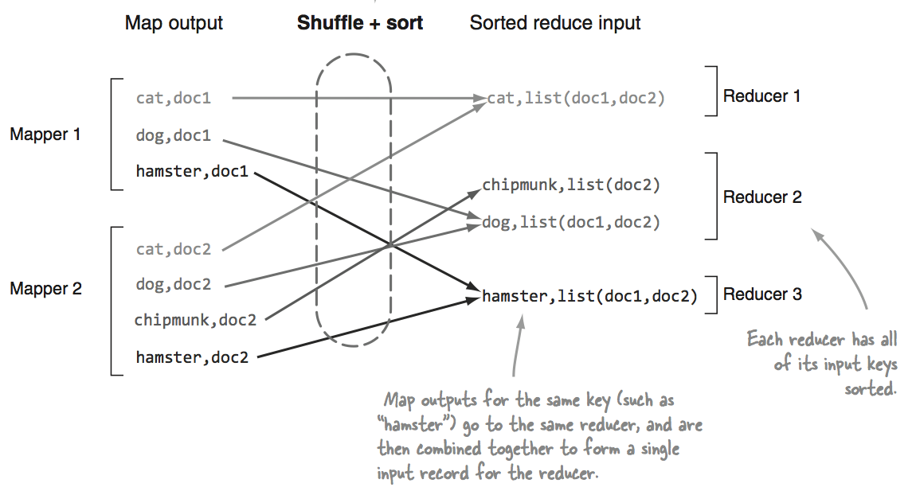
3. Shuffle & Sort (continued)
3.b. Sort:
Partitioners sorts the set of intermediate keys. Merging the map outputs by key, and sorting them by key
This allows the reducer to work on a continuous chunk of values for each key.

Slide 28
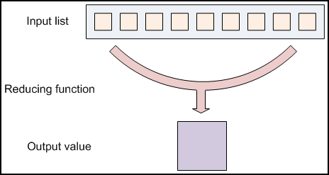
4. Reduce
For each key in the partition assigned to a Reducer, the Reducer’s reduce() method is called once
The reduce() method receives a key as well as in iterator over all the values associated with the key. The values associated with the key are returned by the iterator in an undefined order.
Reducer combines or aggregates the values together, returning the final key/value pairs.

Slide 29
5. output
Hadoop’s OutputFormat class describes the output-specification for a MapReduce job.
OutputFormat is responsible for:
Validating the output-specification of the job. (e.g., check that the output directory does not already exist)
Provide the RecordWriter, which writes out the output files of the job.
Output files are stored in HDFS.

Slide 30
YARN: Hadoop’s MapReduce processing engine

Slide 31
MapReduce Jobs and Tasks
A Job is a full program, the complete execution of Map and Reduce functions across all input data.
A Job is composed of many Tasks, the execution of a single attempt of a Map or Reduce on a block of data. Tasks are controlled by the Node Manger.
A Task attempt is a particular instance of a task:
There are at least as many attempts as tasks
If a task attempt fails, another will be started by the ApplcationMaster
If attempts become slow or unresponsive, Hadoop ensure consistency in computation by a method called speculative execution.

Slide 32
MapReduce Version 1 and Version 2
MapReduce V1 (or “classic MapReduce”)
Uses a JobTracker/TaskTracker architecture
One JobTracker per cluster – limit cluster size to about 4000 nodes
Slots on slave nodes designated for Map or Reduce tasks
MapReduce V2
Built on top of YARN (Yet Another Resource Negotiator)
Uses ResourceManager/NodeManager architecture
Increases scalability of cluster
Node resources can be used for any type of a task
Improves cluster utilization
Support for non-MR jobs

Slide 33
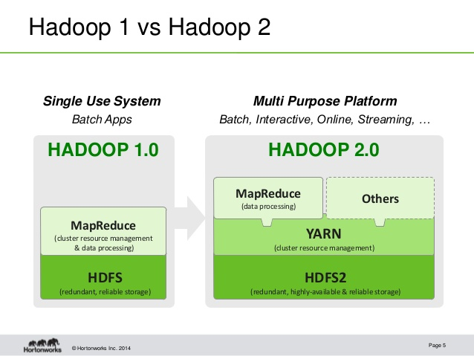

Slide 34
Hadoop 2 on YARN
YARN → Yet Another Resource Negotiator
YARN is the resource management and computation framework that is new as of Hadoop 2, which was released late in 2013
YARN implements a MapReduce Application, therefore for the most part, discussing MapReduce as a distributed computational framework of Hadoop is correct, however YARN expands on the distributed computational ability that is available in Hadoop

Slide 35
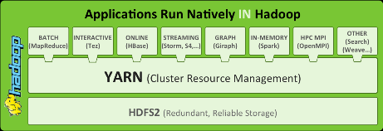
YARN supports multiple processing models in addition to MapReduce.
All share common resource management service
No need to ship out data!

Slide 36
From MR V1 to MR V2
JobTracker is renamed ResourceManager
TaskTracker is renamed NodeManager
ResourceManager does not handle tasks in a job.
ResourceManager allocates cluster resources (memory and CPU cores) for an application
Launches an ApplicationMaster on one of the slave nodes
ApplicationMaster does most of what the JobTracker used to do

Slide 37
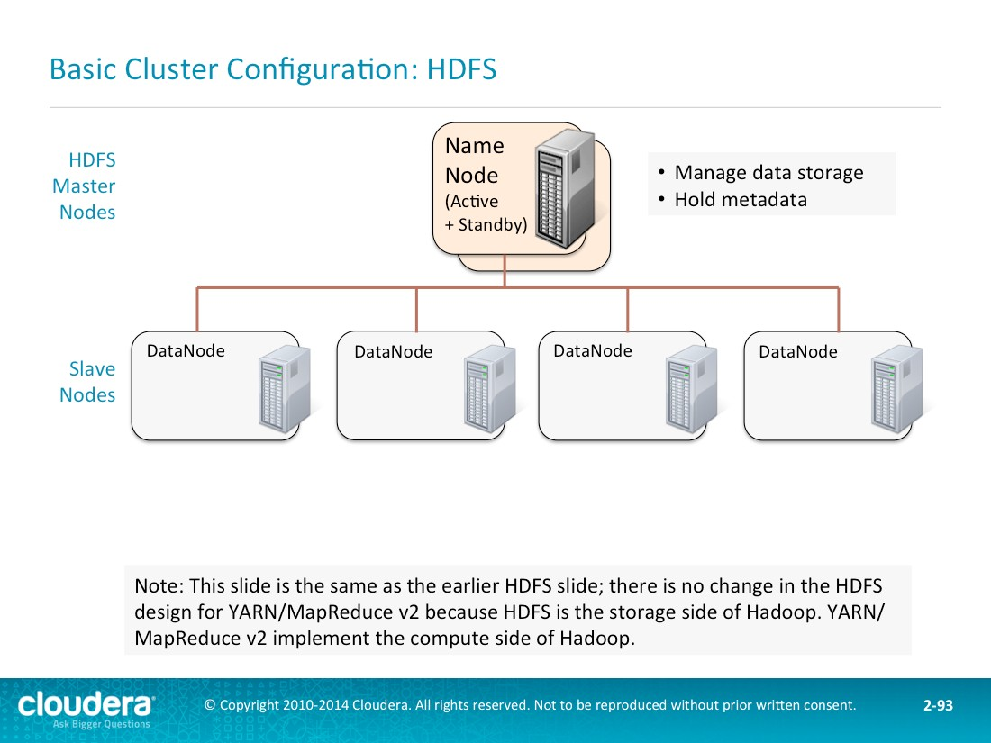

Slide 38
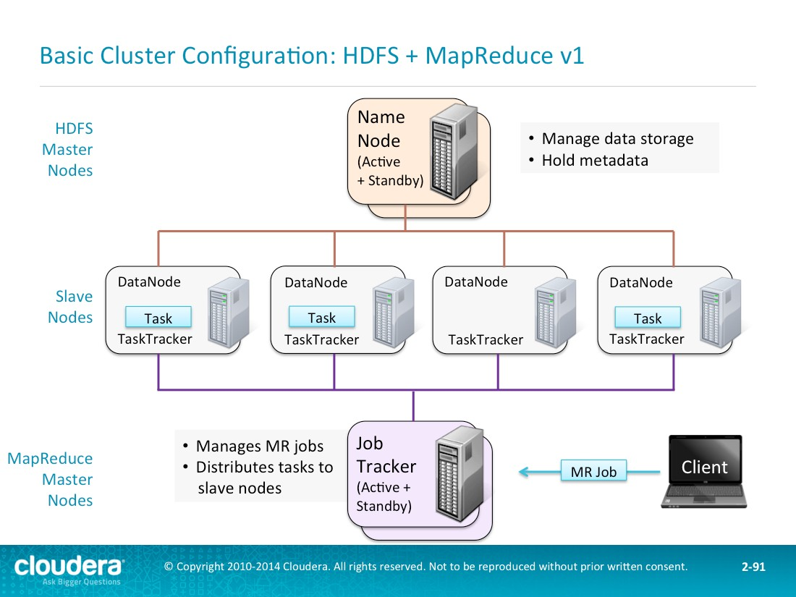
Notes:
JobTracker: manages MapReduce jobs, schedule tasks
Task tracker:
Responsible for instantiating and monitoring individual Map and Reduce tasks. Runs on salve nodes along with DataNode Daemon

Slide 39
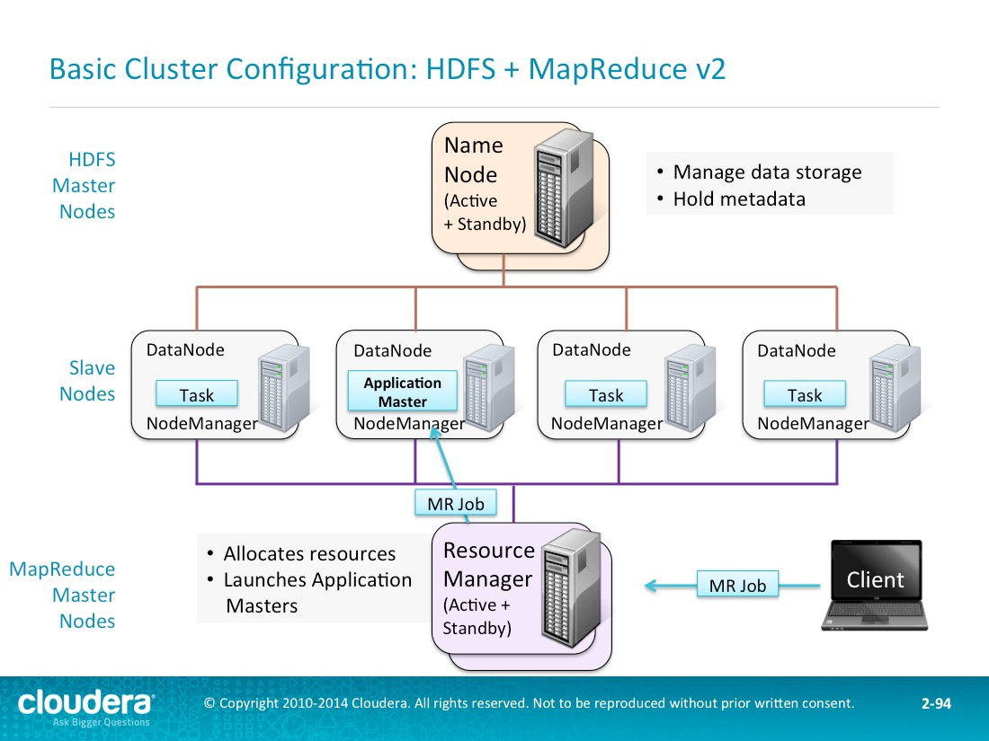

Slide 43
Details of Job Submission
Clients submits Job to ResourceManager and asks it to run an applicationMaster process
ResourceManager picks a NodeManager and runs ApplicationMaster on it
ApplicationMaster contacts NameNode to get block locations for every input path.
ResourceManager hands out map tasks to NodeManagers giving preference to machine that have a block of data local
NodeManagers load their local blocks and process all records in that block
When each mapper finishes, it writes its output to its local disk

Slide 44
Detailed Job Submission (continued)
Once a percentage of the mappers are done, ResourceManager begins to distribute reducer tasks
Reducers simply copy mapper outputs at this phase
Resource manager spins up other MR tasks to deal with errors
Once all the mappers are complete, ResoucreManager tell reducers to run their reduce() method
Reducer output is written to HDFS.

Slide 45
Important!
Reduce tasks can run anywhere in the cluster, but map tasks have locality constraints (Data Local Computing)
Map tasks must run on the nodes that store the blocks of the input data file.

Slide 51
Speculative Execution
If a single map or reduce task is running significantly slower than its peers (20% by default), Hadoop tries to spin up the same task on another separate slave node
A new task attempt for the same task
Whichever task finished first is the “winner” – its output is used and the loser is terminated
This makes sense for the mappers, but not for reducers, why?

Slide 52
Speculative Execution (continued)
All mapper have almost the same input size (which is one block of file) and all mappers do almost the same amount of work
However, the size of reducers’ inputs may be different:
e.g., Sales in November-December time range is higher than January-February

Slide 53
Handling Failures
Task Failure
ApplicationMaster failure
NodeManager failure
Resource Manager failure

Slide 54
Task Failure
Eack Task reports the error to its parent ApplicationMaster before it exits.
ApplicationMaster also monitors tasks and notices hanging tasks that do not report progress for a certain amount of timeout
Once a task is failed or hanged, ApplicationMaster frees task’s resources and reschedules the failed task on another NodeManger
If a certain task fails for 4 times, the whole job fails

Slide 55
ApplicationMaster Failure
An application master sends periodic heartbeats to the resource manager
If the resource manager notices the failure, a new application master is restarted on a new node
Resource manager tries to recover the job history of the failed application master so that the job do not rerun
As needed, clients contact the resource manager to get the address of the new application master.

Slide 56
NodeManager Failure
Resource manger notices a NodeManager that has stopped sending heartbeats
Any task or application master that was running on the failed node is recovered as explained before
Map tasks on the failed node will run again because the intermediate results are lost

Slide 57
ResourceManager Failure
Failure of ResouceManager is serious.
Stand by ResourceManagers are run to take over without a significant interruption to clients
ResourceManager state is stored on HDFS for fast recovery

